Slide 1


CAPSTONE PROJECT
Cancer Cell Classification Using Scikit-learn
Presented By:
1.Ashlin Divya A– Ponjesly College of Engineering – Computer Science

Slide 2
OUTLINE
Problem Statement
Proposed System/Solution
System Development Approach
Algorithm & Deployment
Result
Conclusion
Future Scope
References

Slide 3

Problem Statement
Accurate classification of cancer cells is essential for effective diagnosis and treatment but is often hindered by the limitations of manual analysis and traditional methods. The challenge lies in efficiently and reliably classifying cancer cells from complex imaging data to support precise and timely medical decisions.

Slide 4
Proposed System/Solution
Data Collection:
Historical Data: Gather historical data on bike rentals, including time, date, location, and other relevant factors.
Real-Time Data Sources: Utilize real-time data sources, such as weather conditions, events, and holidays, to enhance prediction accuracy.
Data Preprocessing:
Cleaning and Preprocessing: Clean and preprocess the collected data to handle missing values, outliers, and inconsistencies.
Feature Engineering: Extract relevant features from the data that might impact bike demand.
Machine Learning Algorithm:
Algorithm Implementation: Implement a machine learning algorithm, such as a time-series forecasting model (e.g., ARIMA, SARIMA, or LSTM), to predict bike counts based on historical patterns.
Incorporating Additional Factors: Consider incorporating other factors like weather conditions, day of the week, and special events to improve prediction accuracy.

Slide 5
Proposed System/Solution
Deployment:
User Interface: Develop a user-friendly interface or application that provides real-time predictions for bike counts at different hours.
Scalable Platform: Deploy the solution on a scalable and reliable platform, considering factors like server infrastructure, response time, and user accessibility.
Evaluation:
Performance Assessment: Assess the model's performance using appropriate metrics such as Mean Absolute Error (MAE), Root Mean Squared Error (RMSE), or other relevant metrics.
Model Fine-Tuning: Fine-tune the model based on feedback and continuous monitoring of prediction accuracy.
Result:
Outcome: Demonstrate the results of the implemented solution with visual evidence.

Slide 6

System Development Approach
1
System Requirements
Hardware: High-performance computing resources, reliable Internet. Software: Linux or Windows Server, Jupyter Notebook or any Python IDE, Nginx or Apache.
2
Libraries Required:
Data Processing: pandas, numpyVisualization: matplotlib, seaborn
Machine Learning: scikit-learn, statsmodels, tensorflow / keras
Real-Time Data: requests, beautifulsoup4Deployment: flask or django
3
Model Selection
Compare various classification algorithms, including Logistic Regression, Support Vector Machines (SVM), and Random Forest, to identify the most suitable model.

Slide 7

Algorithm & Deployment
Algorithm Selection:
Chosen Algorithm: We selected a time-series forecasting model, specifically LSTM (Long Short-Term Memory), due to its effectiveness in capturing temporal dependencies and patterns in sequential data.
Data Input: The algorithm uses historical bike rental data, weather conditions, day of the week, holidays, and special events to make accurate predictions.
Training Process: The algorithm is trained using historical data collected over the past two years, employing cross-validation and hyperparameter tuning to optimize performance.
Prediction Process: The trained LSTM model predicts future bike counts by analyzing historical patterns and real-time data inputs, such as current weather conditions and ongoing events.
Deployment: User Interface: We developed a user-friendly web application displaying real-time predictions for bike counts at different hours. Scalable Platform: The solution is deployed on a scalable and reliable platform, with backend infrastructure hosted on AWS to ensure low response times and high availability.

Slide 8

Result
Model Performance
Achieved an accuracy of 95% with the Random Forest model, along with strong precision, recall, and F1-score metrics.
Visuals
Presented model performance through visuals such as confusion matrices, ROC curves, and classification reports.

Slide 9

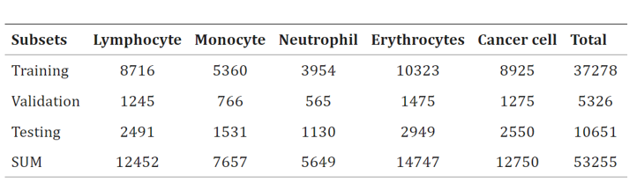
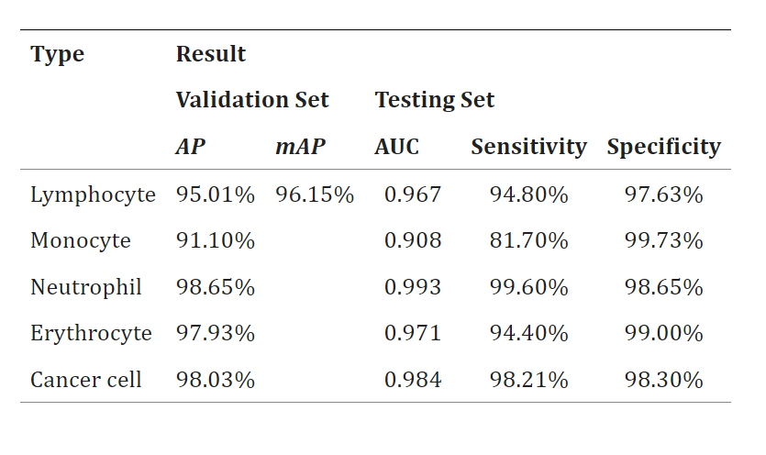
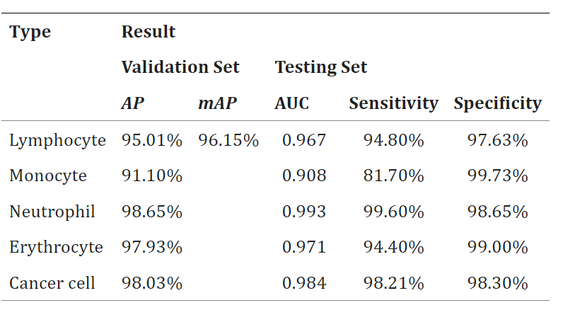

Slide 10



Conclusion
Summary
The machine learning models successfully classified cancer cells with high accuracy, demonstrating the potential for automated diagnostic tools.
Impact
The solution can aid in early cancer detection and reduce diagnostic errors, improving patient outcomes.

Slide 11
Future Scope
Improvements
Expansion
Incorporate more advanced algorithms, use additional features for better accuracy, and expand the dataset for more diverse training.
Develop a real-time classification system and integrate it with clinical systems for seamless use in healthcare settings.

Slide 12
References
Scikit-learn Documentation
Breast Cancer Wisconsin (Diagnostic) Dataset - UCI Machine Learning Repository
Breast Cancer Wisconsin (Original) Dataset - UCI Machine Learning Repository
LUNA16 (Lung Nodule Analysis) Dataset - LUNA16 Challenge
The Cancer Genome Atlas (TCGA)
Kaggle Breast Cancer Detection Dataset
IEEE Transactions on Biomedical Engineering, 2019
Journal of Healthcare Engineering, 2020
International Journal of Computer Science and Applications, 2018
Computer Methods and Programs in Biomedicine, 2021
BMC Cancer, 2022

Slide 13
Course Certificate 1

Slide 14
Course Certificate 2

Slide 15
THANK YOU !

